Slide 1
Professional Inquiry Project
By Taylor Fornwald
Can Technical Theatre students feel like they are a significant role and feel included as part of the show's "team"?

Slide 2
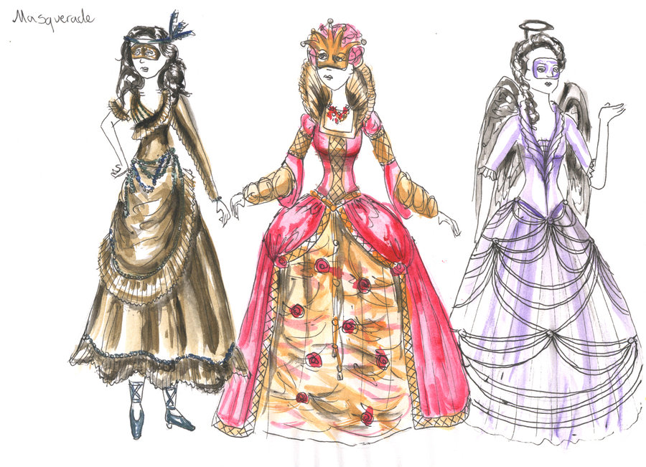
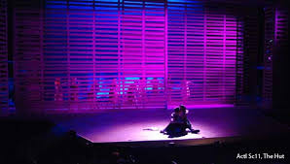
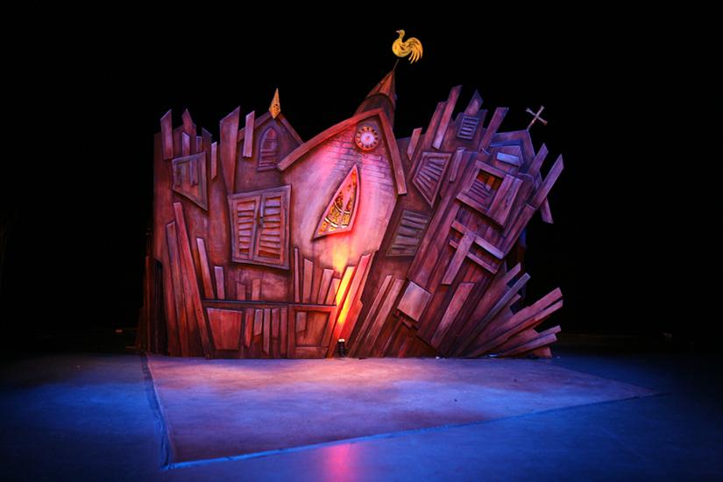
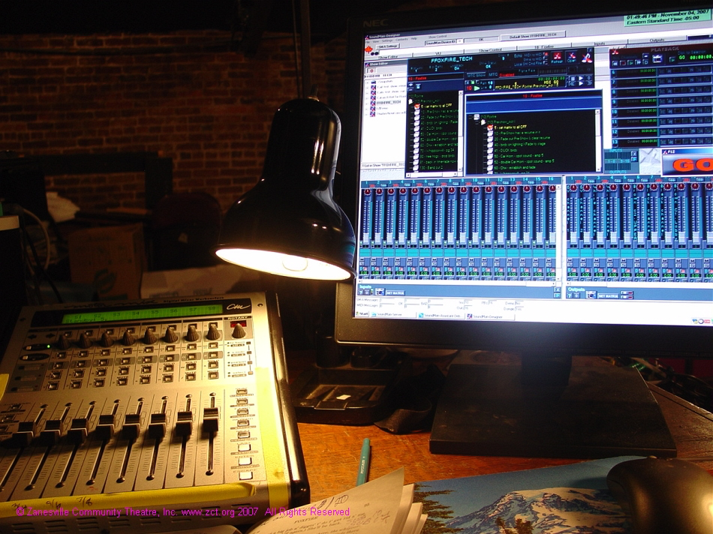
What is Technical Theatre?
Notes:
Technical theatre is a look at what happens behind the scenes of a production. In my class we explored all of these Theatre Management, stage Management, Costumes, Sound, Lights, Props, and Set. It is the magic that happens that allows to make actors shine and for the show to run.

Slide 3
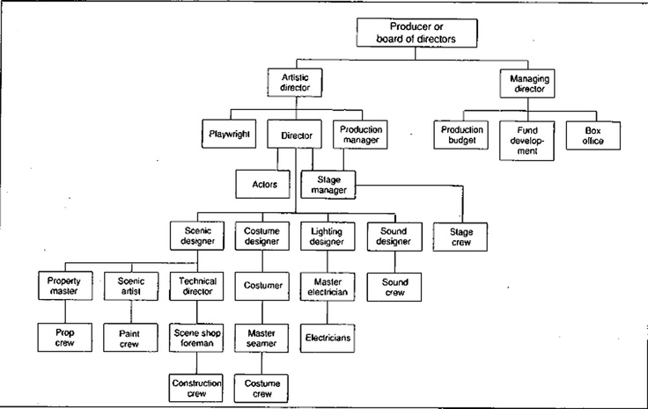
Theatre Roles
Notes:
On the first day I showed my Technical Theatre class this picture and they were amazed at how many roles there were in the “behind the scenes” of a production. We chatted about each of the jobs and and how they are all interconnected in one way or another and the main idea to remember when working on a show is Teamwork and Communication. I then broke down all the roles into chunks and taught lessons on and had them do mini assignments for the Management side of theatre, Costume, Sound, Lights, Set and Props. These lessons and assignment allowed students to understand the design aspects of theatre so that when it came to choosing jobs for the semester and working on various shows in the Chinook Fine Arts they had a background knowledge of them all.

Slide 4
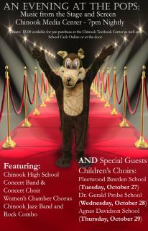
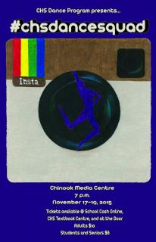
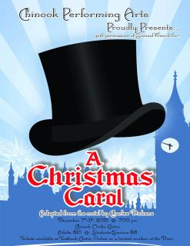
Chinook Fine Arts
Notes:
Students had the opportunity to sign up for various roles throughout the semester for the many shows that the Chinook Fine Arts Department to put on. This included sound, Lights, and Projection running for the Fall Music show, Sound and Lights for a music variety show called LA City Limits. Lights, Sound, Projection, and Stage Management for #chsdancesquad fall dance production. Each students had a chance to work one gig that they were interested in and got a first hand look at how different shows work and how important tech is to each performance. Students would particpate in all tech and dress rehearsals and performances for their role as well which taught them how valuable communication is.

Slide 5
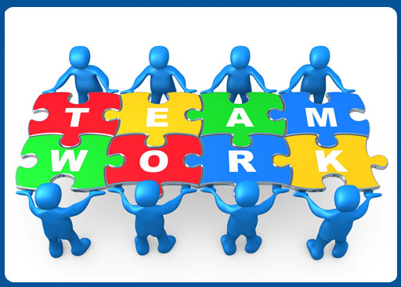
Teamwork
Notes:
My next task was teaching students team work. Often Tech people that work on projects get forgotten and feel alone as they are often given a task that they can do on their own and sometimes means being secluded in a different part of the theatre or space the performance is happening. In order for my students to grow together as a team they Planned, Promoted, designed, Built and ran a Haunted House at our school for two days.

Slide 6
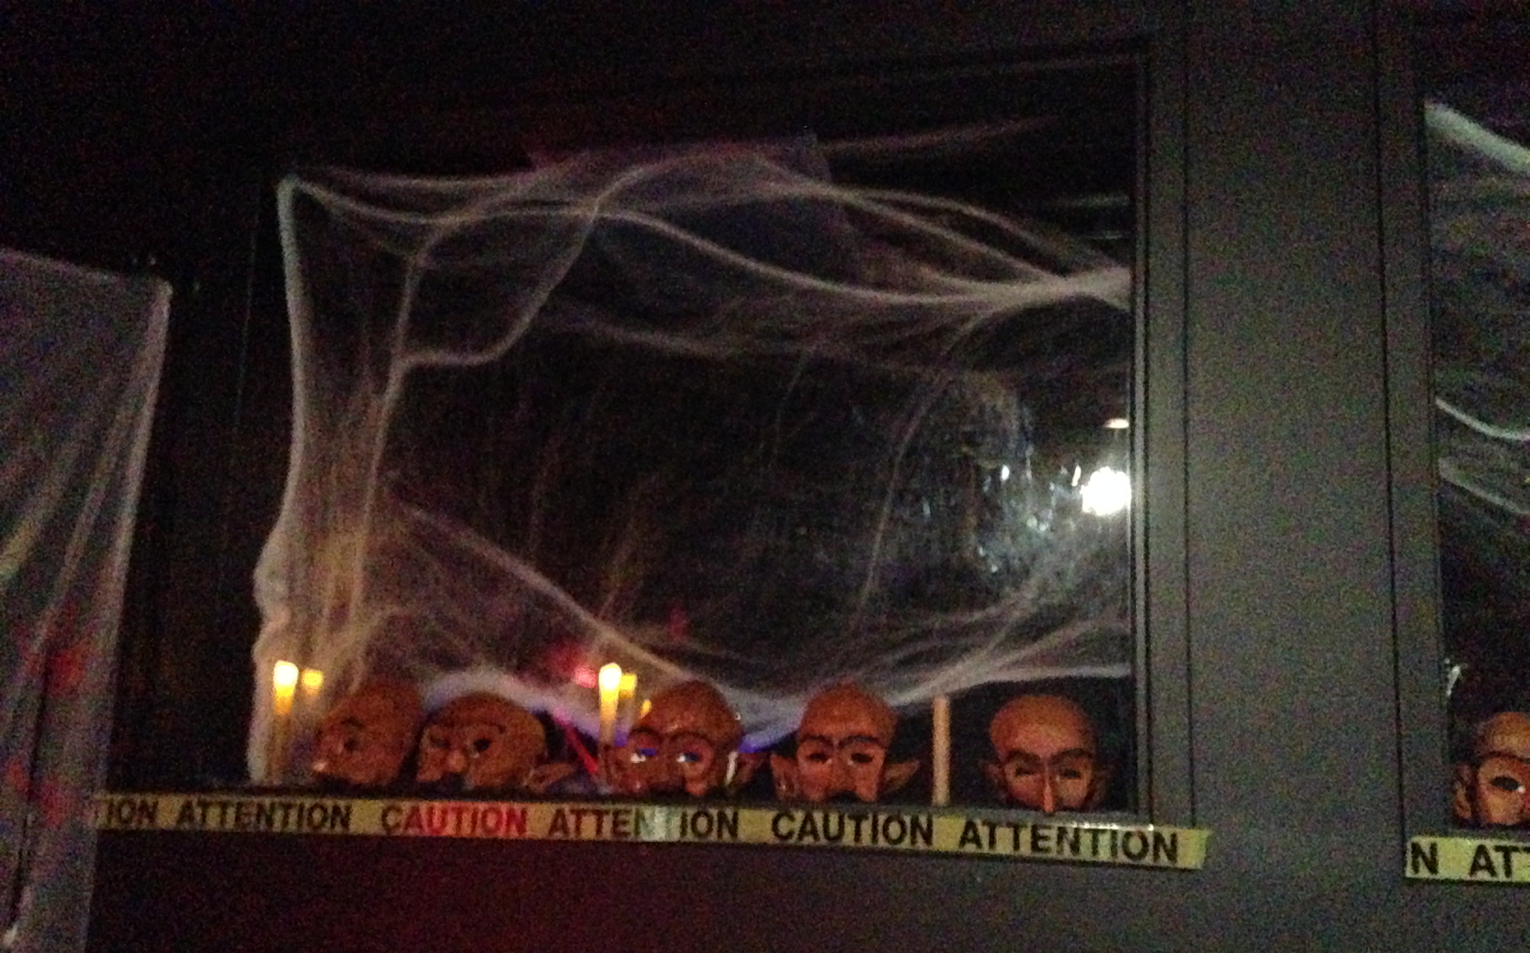
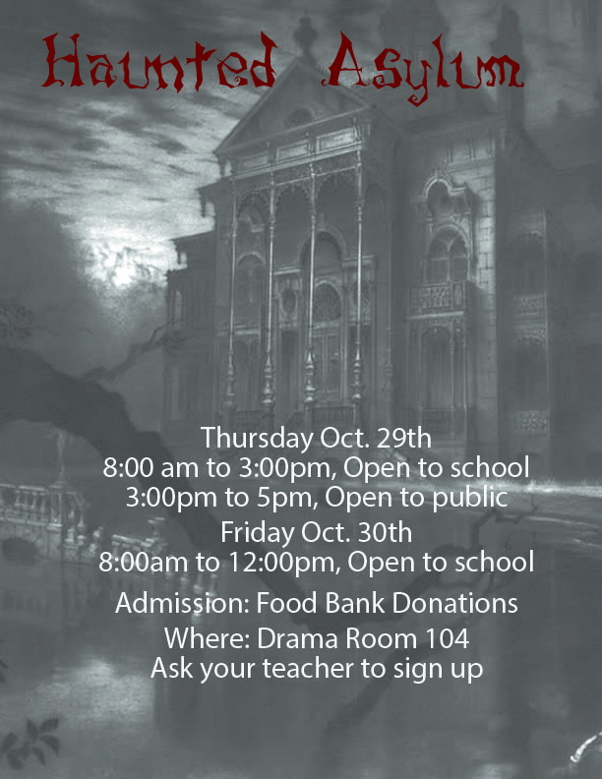
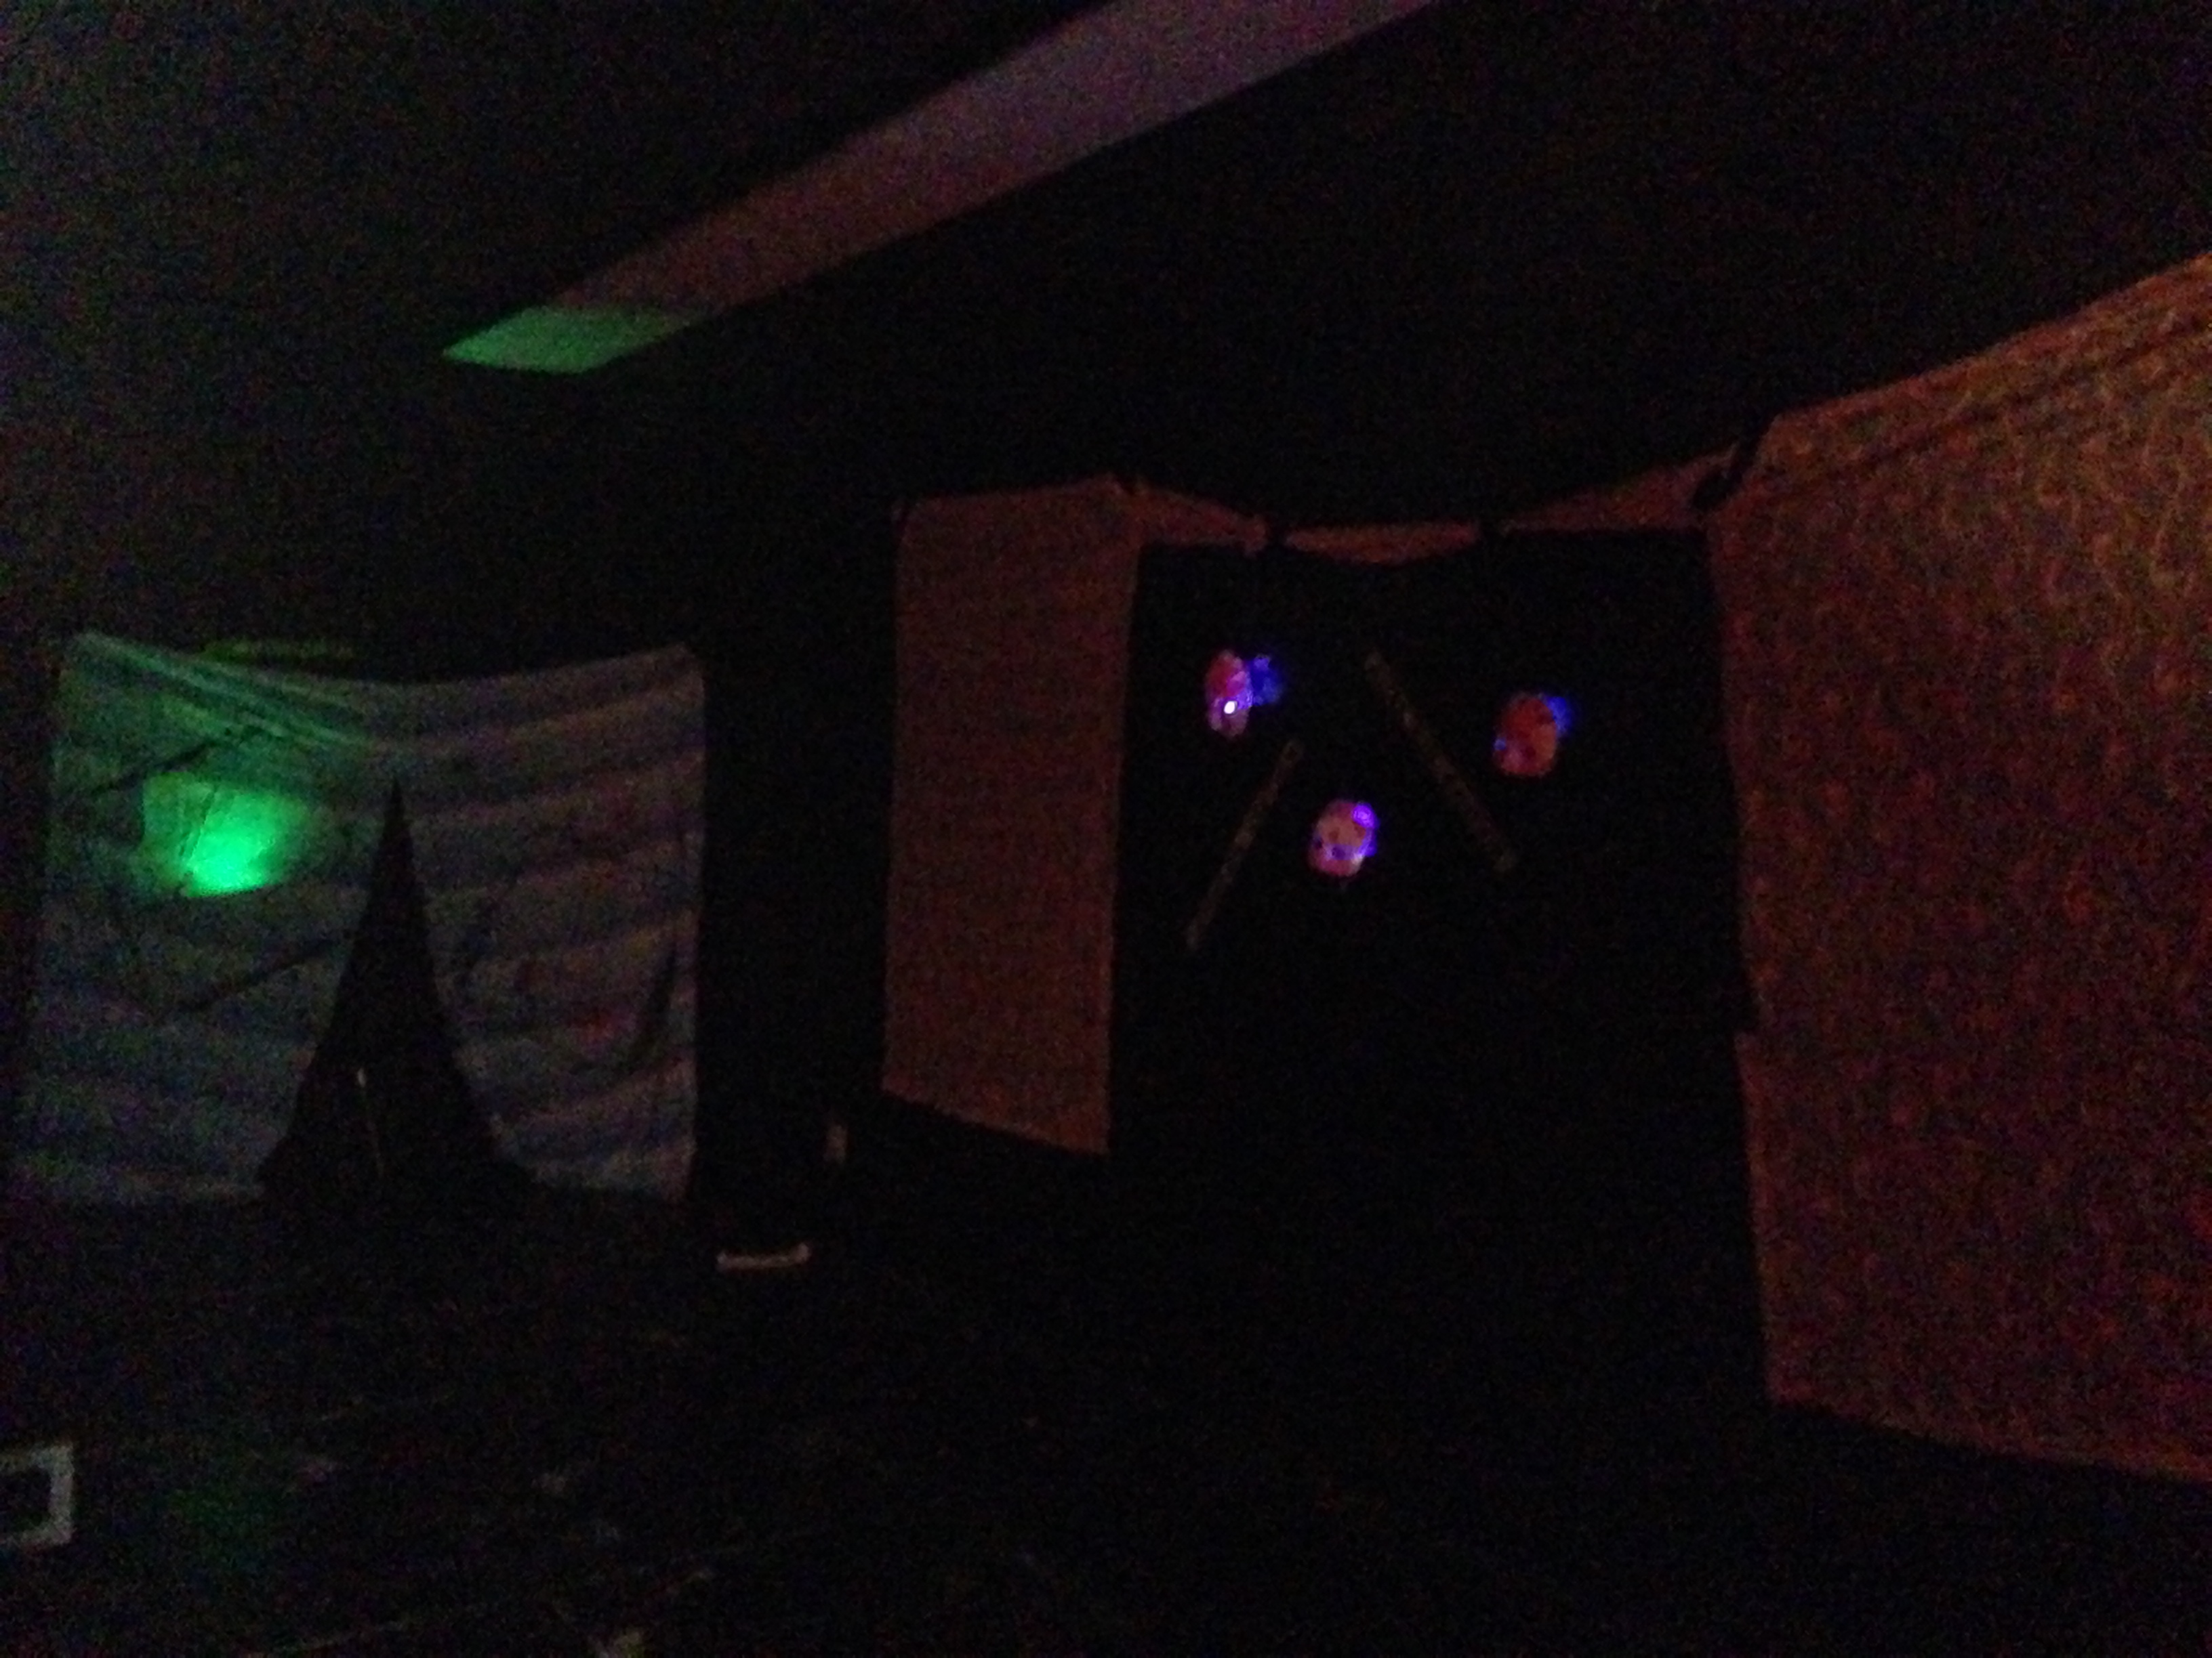
Haunted House
Notes:
Students signed up for various roles to be part of the Haunted House including Management and Promotion, Costume and Make up, Sound, Set, and Lights design. Students were then in charge of doing all the research planning and creating lists of supplies that I then went out and purchased. They then worked as a team to build the Haunted House, hang posters, create other promotions or the Haunted House. They then were a part of the acarying and acting along side my Drama 10 class. It ended up being a huge success and really allowed my class to come together. These were all students who knew each other but not really friends since Chinook High School is quite a big school. The project definitely changed that though and they really became a team that I think really benfited when it came to the process of working on shows.

Slide 7
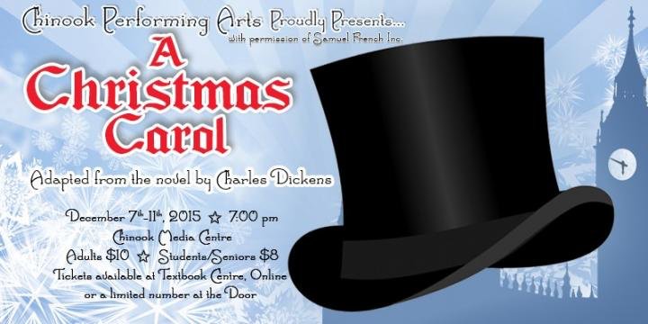
A Christmas Carol
Notes:
From the Haunted House students then signed up for roles to be part of the Tech Team for the fall production of “A Christmas Carol”. These roles included Head of props, Running Crew, Head of Costume, Hair and Makeup Crew, Light And Sound Board Operators. Most of this class was done outside of class and students get marked and credit from the jobs they sign up for and do. Students still had regular classes as well two to three times a week where after the Haunted House we painted set pieces, Created props, organized costumes, props, and the backstage areas and various other small jobs. Needless to say my students put in many hours on this production because on top of class they attended various rehearsals and whole week of running tech for the show and now this week we have had nightly performance and three matinees for total of 8 shows with our last tonight.

Slide 8
The Question
Can Technical Theatre students feel like they are a significant role and feel included as part of the show's "team"?
Notes:
I decided on this question at the beginning of my practicum and allowed it to shape my process and planning for the class. I asked my students to think about this question various times throughout the semester and then got them to answer it this week as “A Christmas Carol” comes to a close. I got some great responses and now as it all comes to an end I can finally answer this question. Yes! But also sometimes no…. Because as a teacher there are always ways for growth and improvement and definitely time to reflect and improve on my process.

Slide 9
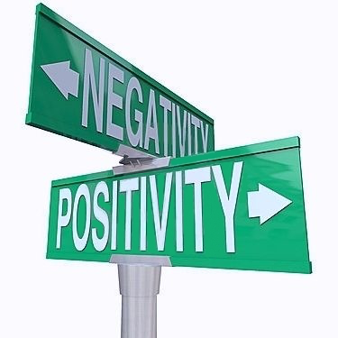
The Data
Notes:
For most students responses I had some mixed feelings of whether they had a vital role and that is why I have decided the answer to this question is both Yes and No. Some students said that at first they did not feel respected in their role especially by some of the older students that had tech roles for credits for the upper level class that was not my own. They also sometimes felt that they were not respected for their work by everyone in the cast and not always got thanked for their work, I would be running around backstage and often felt not appreciated because some cast would never thank me”. Lastly, “sometimes just felt out of place and maybe a little lost in the job I was assigned”. With theses negatives those each student had a positive spin as well. They commented their job was fun and had something to constantly do and fun to see how everything worked backstage. One students said “ I like my job because it is fun and I don’t have to sit in a chair for the whole play”. Other student commented that it was quite nerve racking but very rewarding when it all was completed, “we feel amazing because we just helped in creating magical moments for the audience. Overall though they stuck together as a class and supported each other as one students said “We all stuck together with each other and worked together. We all showed up a joked around, enjoying the experience.”

Slide 10
My Conclusions
Notes:
I will take this data, good and bad, to improve the way I teach a class to this in the future or when working on a school production. I will maybe take more time to sit with all tech students, whether they are my class or not, to go voer proper protocals so they feel more important and confident with one anther. I will then also take more time to explain to the cast each role and how they should respect them and why they are vital to the overall process. At the end though my class has grown super close and think found some new friendships. They have a huge amount of respect for me because they not only took time to write me these responses and reflections during a very busy week of show and were brutually honest with me which I always love because that is how they, learn. Each students also ended their response to me by saying they would love to learn more and continue to work on tech for shows at Chinook. So overall I think a wonderful learning experience for everyone. To go hand in hand with this quote.

Slide 11
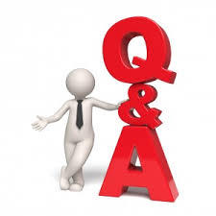
Questions?

